Slide 1

Painter User Guide

Slide 2
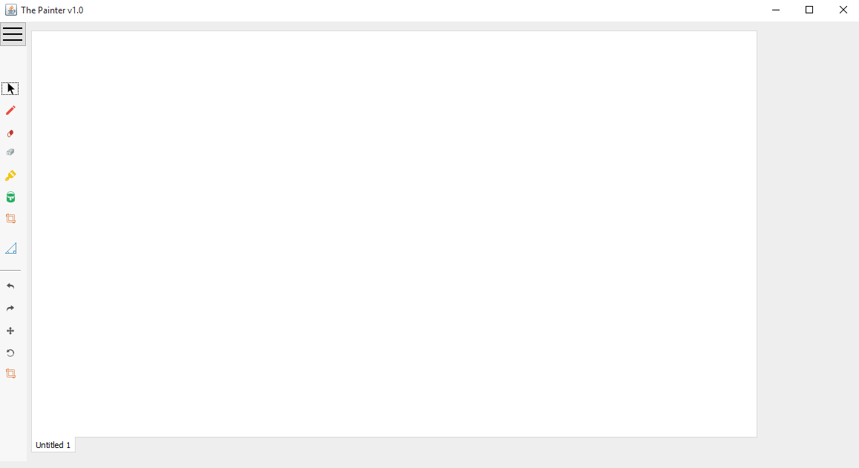
User Interface
Menu bar
Toolbar
Drawing Area

Slide 3
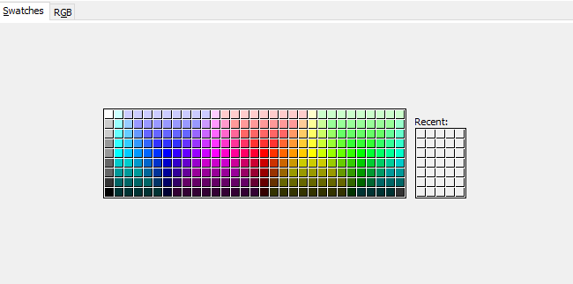
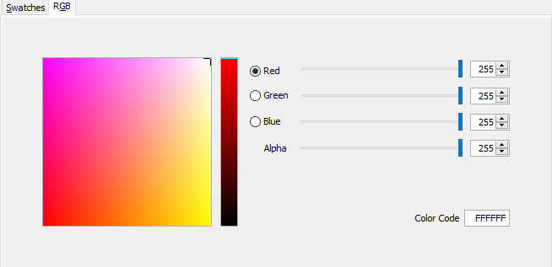
Cursor Tool used for selecting shapes on Canvas.
To select a shape, click on any point contained inside the shape.
Eraser tool used for deleting a shape.
To delete a shape double click any point contained inside the shape.
Fill tool used for selecting shape color
To select a color, choose desired color from swatches or select the suitable RGB color

Slide 4

Shapes tool used for selecting a shape to be drawn
To draw a shape, open the shapes panel and choose a shape.
Press at the desired point in the drawing area, hold and drag until desired size is chosen.
Release mouse for the shape to be drawn.
Shapes available:
Ellipse – Circle
Rectangle – Square
Line - Triangle
GIF demonstrating how to draw a shape

Slide 5
Undo
Redo
Used for reverting between changes in the drawing canvas.
GIF demonstrating how to undo/redo works

Slide 6
Resize Tool
Used for resizing shapes in the canvas.
To Resize a shape:
Click on any point within shape boundaries
Drag and release to the desired size.

Slide 7
Resize Tool
To Resize a shape:
Click on any point within shape boundaries
Drag and release to the desired size.
Used for resizing shapes in the canvas.

Slide 8
Brush Tool
To change shape color:
Choose a color from Fill tool
Press anywhere within shape boundaries
Recolor Shape fill
Used for changing Shape fill color

Slide 9
Ahmed Magdy 3003
Doaa Fouad 2844
Dina Nashaat 3124

